Slide 1

Predicting Aircraft Maneuvers to Evaluate the Reliability of Non-Expert Human Observers
2d Lt David Crow, USAF
Air Force Institute of Technology
Graduate School of Engineering and Management
Department of Electrical and Computer Engineering
SP19 csce 623 final project
May 2019
1/12
Notes:
Hi, I’m 2d Lt David Crow.
My research is about Predicting Aircraft Maneuvers to Evaluate the Reliability of Non-Expert Human Observers.

Slide 2
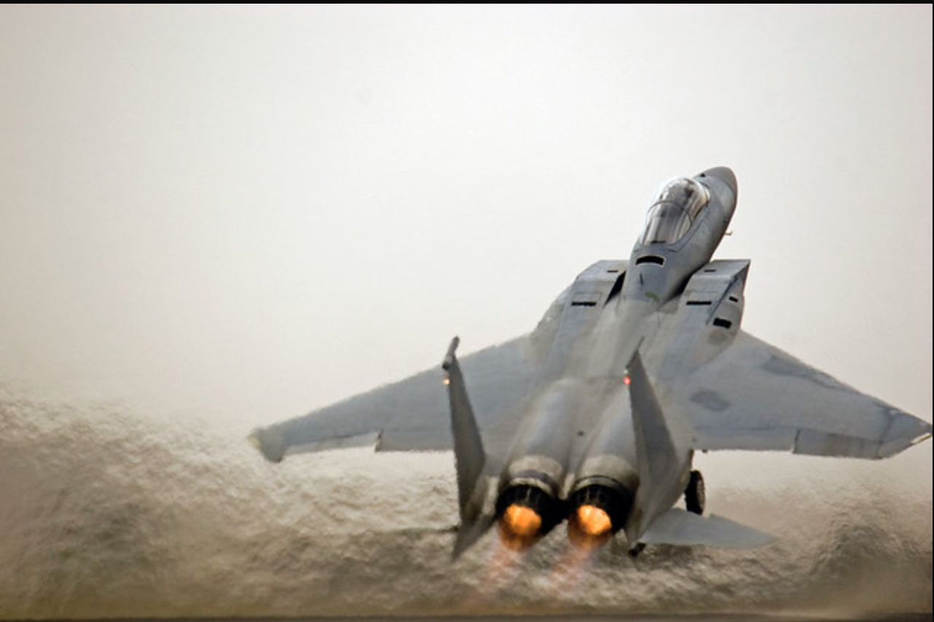
Problem Domain
Non-expert
https://www.grc.nasa.gov/www/k-12/airplane/rotations.html
https://twistedsifter.com/2012/06/pictures-of-airplanes-breaking-the-sound-barrier/
https://www.flickr.com/photos/doigal/434941248
2/12
Notes:
An aircraft's maneuvers in flight are often directly indicated by the plane's roll, pitch, and yaw.
Takeoff, for example, can be defined by a high, positive pitch and low, well-correlated values for roll and yaw. Humans, who are naturally error-prone, might misidentify an aircraft's movement when given only a visual observation of the plane (like we see here). The Air Force is often concerned with the movement of its various aircraft, but, in situations without access to the flight data, it must rely on human observers.
Presently, the Air Force does not know much about the reliability of non-expert human observers in identifying aircraft maneuvers.

Slide 3

Objective
Non-expert human observer’s labels
Expert system’s labels
$$\overset{?}{=}$$
3/12
Notes:
In this research, multiple machine learning models are fit to a set of aircraft characteristics generated by a flight simulator. A non-expert human observer (that's me) labels each of the simulated observations with the maneuver of the aircraft at that point in time. I evaluate each model's performance and then identify which model best predicts the aircraft's maneuver.
An expert system (as defined by a few Air Force pilots) also labels the observations,
and these labels are then compared to those predicted by the best model. In doing so, I can determine whether the human observer provides reliable testimony.

Slide 4
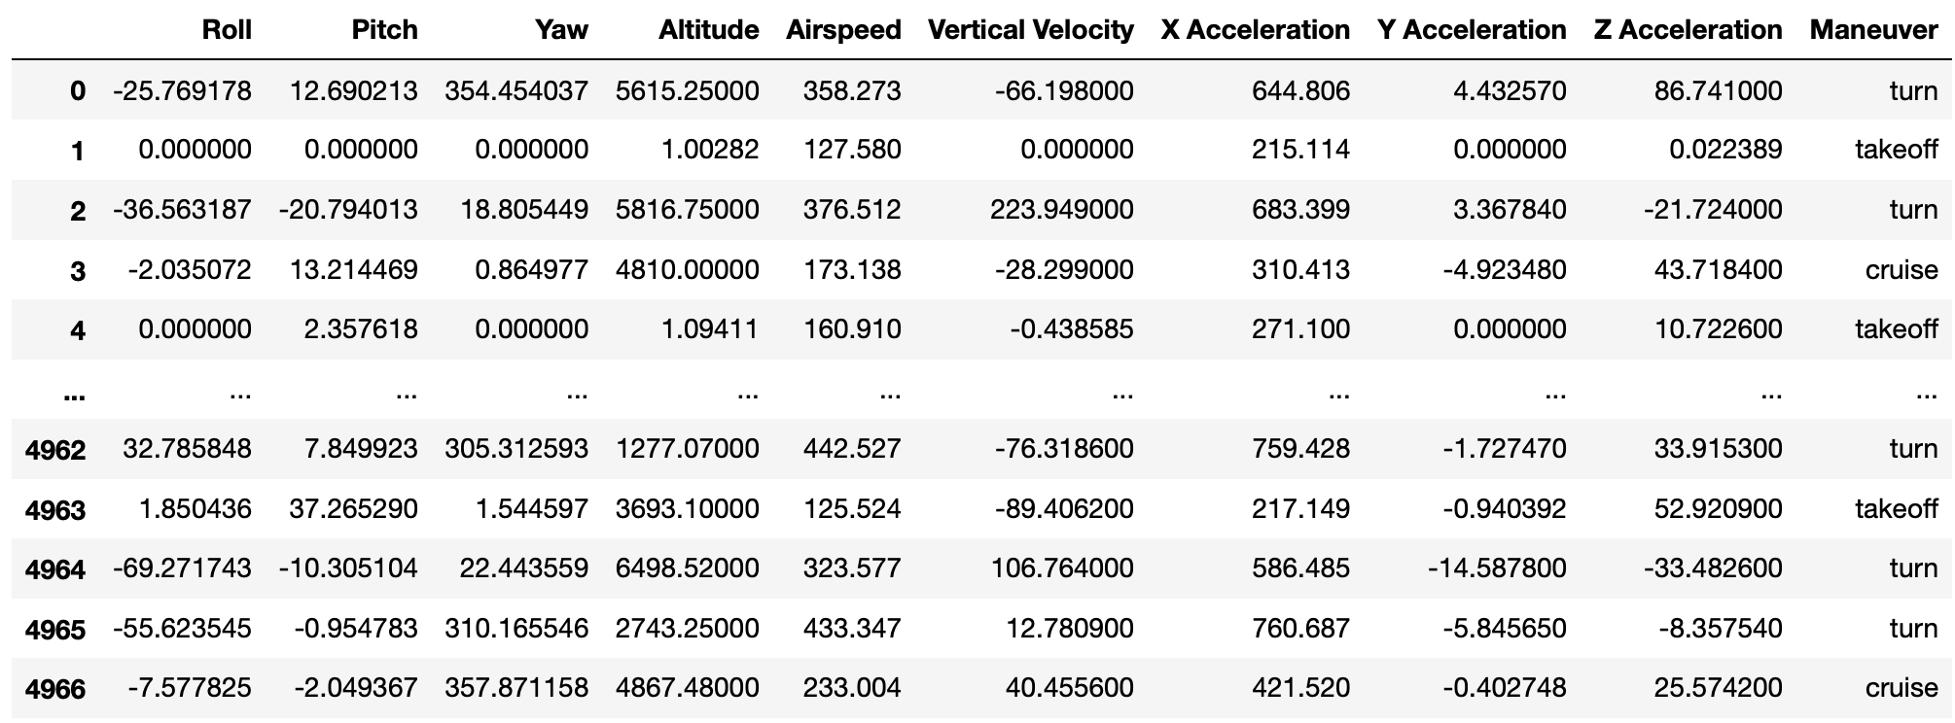
The Data
4/12
Notes:
The Air Force Research Lab maintains a flight simulator, the Avionics Vulnerability Assessment System, or AVAS, which generates the dataset used in this research. At any given moment, the system computes a multitude of metrics about the aircraft; this research concerns the airplane’s orientation, altitude, airspeed, vertical velocity, and acceleration. The simulator is able to display all values as they change over time, and Lt. Marvin and I modified the AVAS source code to enable parameter filtering and file output.
As the non-expert, I flew the simulator and noted time periods where I was taking off, turning, or cruising. By repeating this process, I generated about 5,000 observations evenly distributed over the three classes.

Slide 5
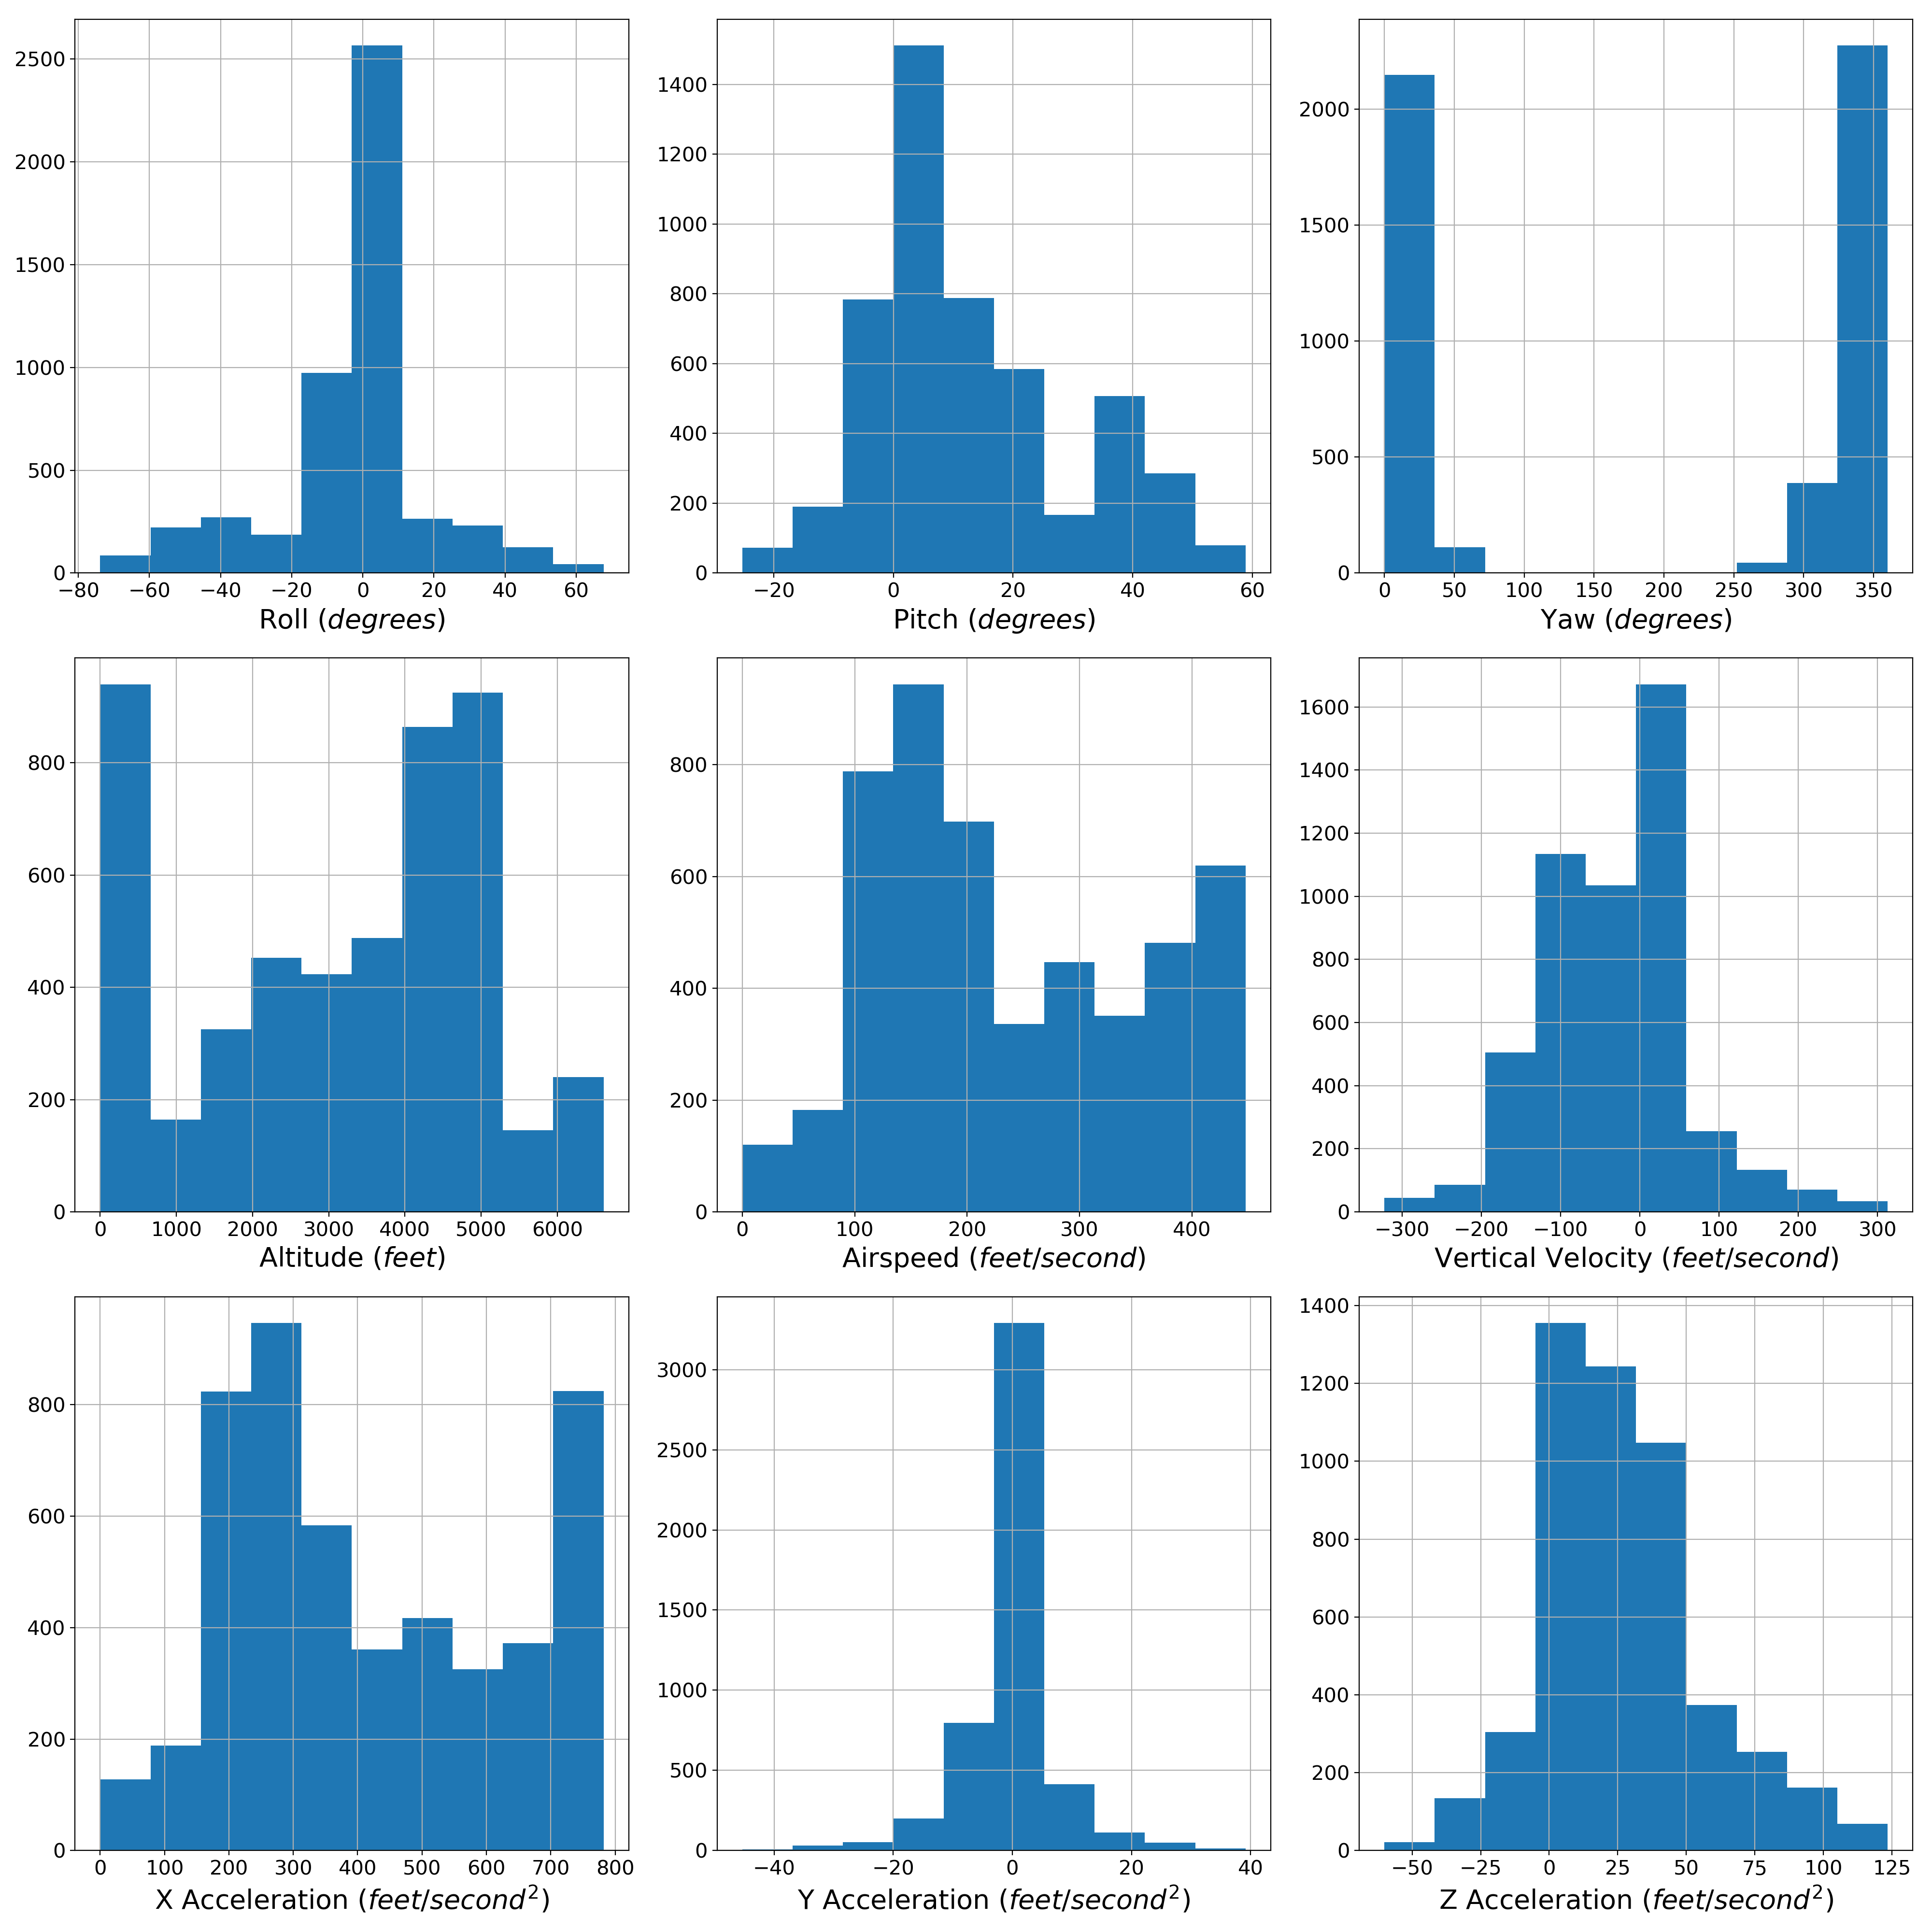

The Data
Feature Histograms
4,968 observations
1,627 takeoff observations
1,673 cruise observations
1,667 turn observations
5/12
Notes:
…we can see the class balance on the left here. After generating the dataset, I proportionally-sampled 90% of each class to build a training set. I converted all orientation measurements from radians to degrees and scaled the training and testing sets
using the training set's mean and standard deviation. In my exploration phase, I found that the simulator's yaw data is just another measure of the airplane's heading,
so I dropped the yaw column to remove noise.

Slide 6
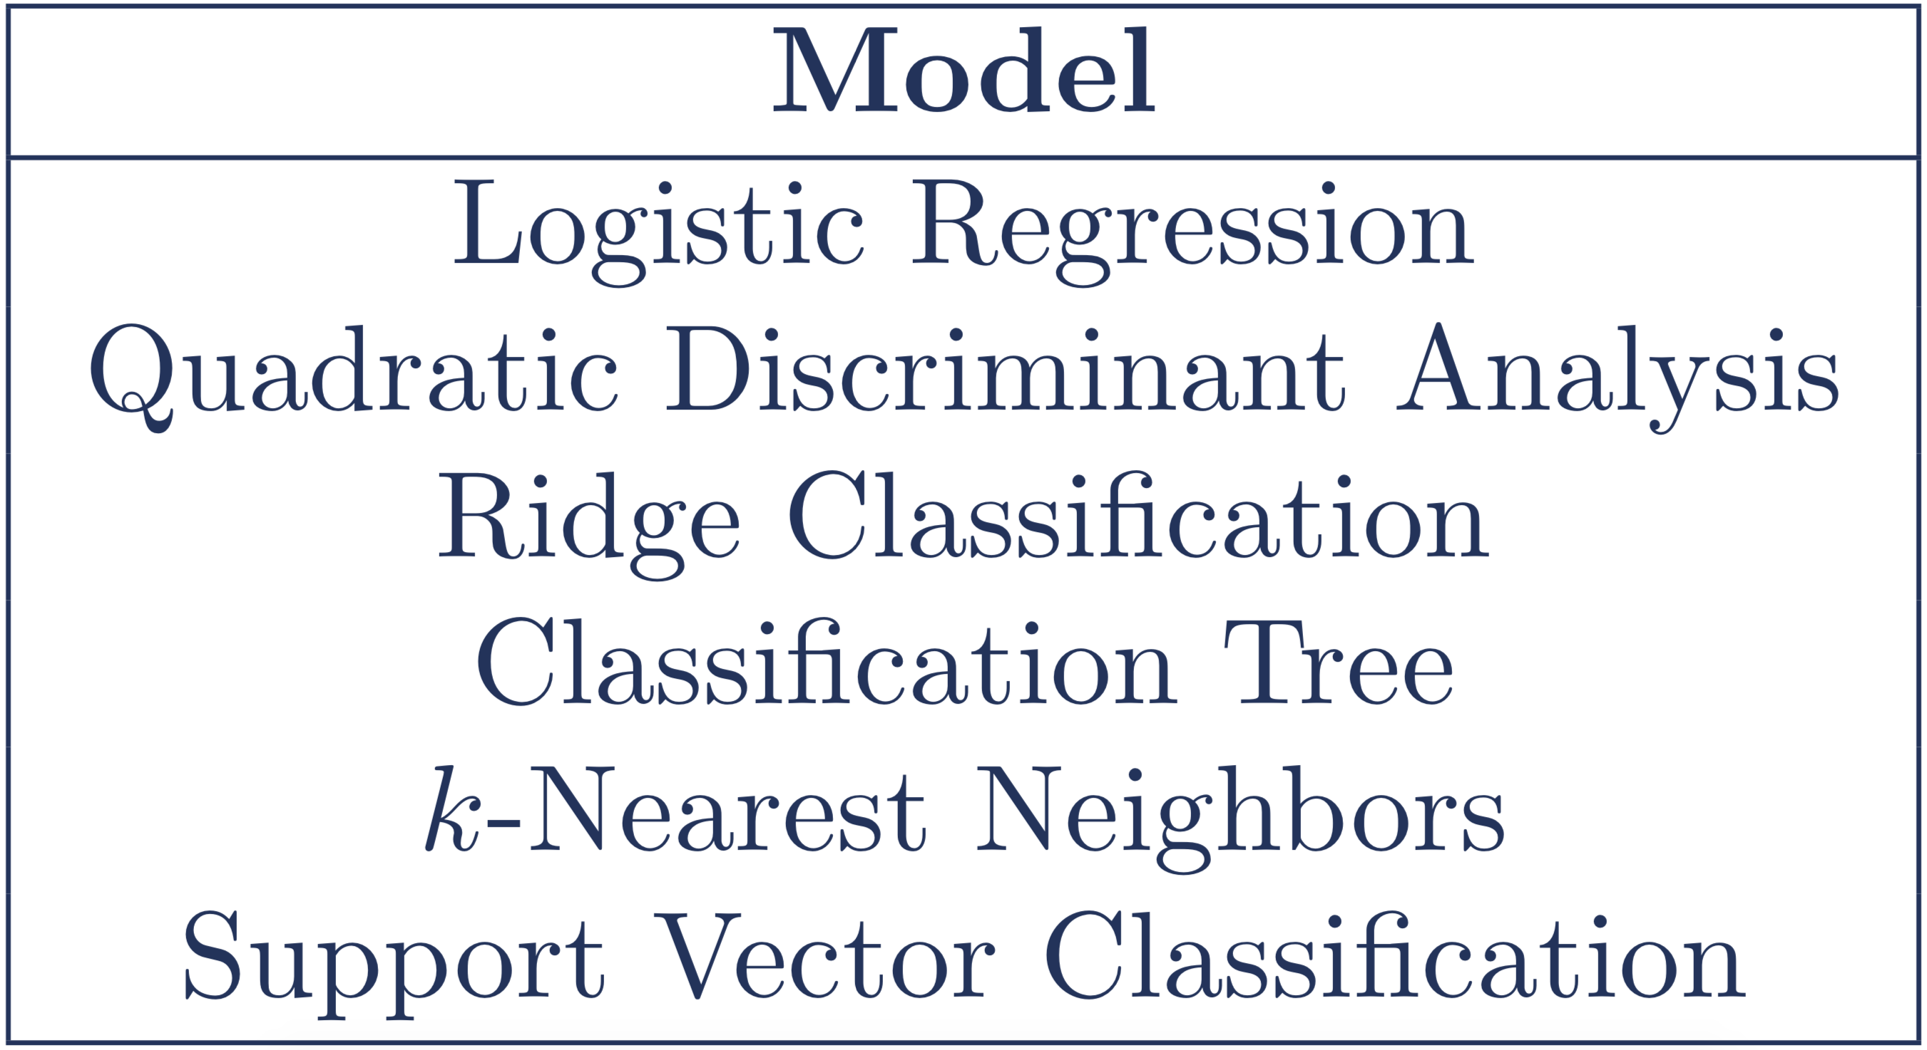
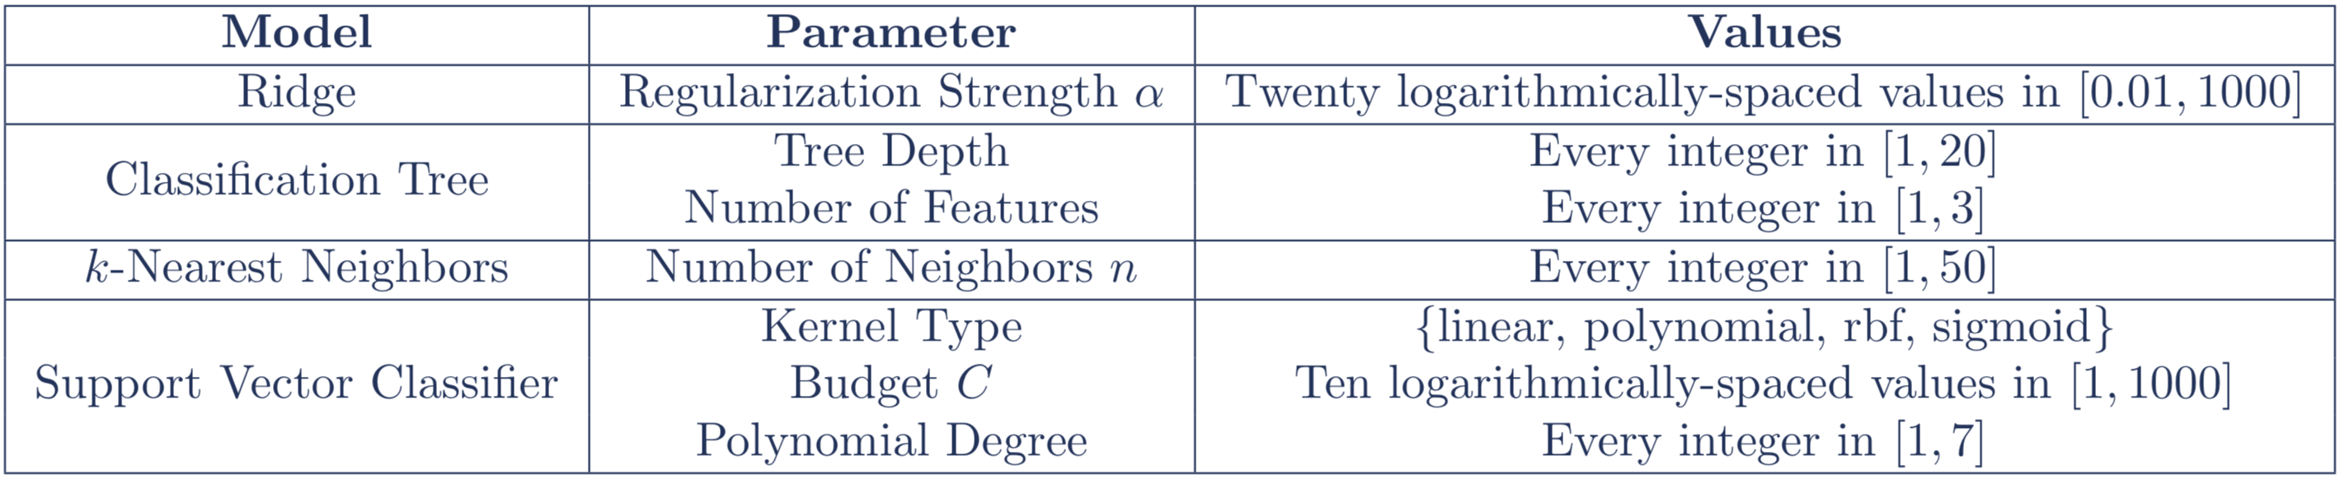
Model Fitting
6/12
Notes:
I then utilized several different machine learning approaches, all with a fair amount of parameter tuning, to identify the best possible model. The tuning values are shown in the bottom table. I validated every version of every model with 10-fold cross-validation and, to ensure reproducibility, I used the same random seed for the entire process. In total, I evaluated 175 different versions of the six model types.

Slide 7
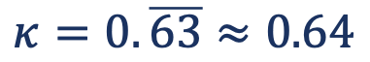
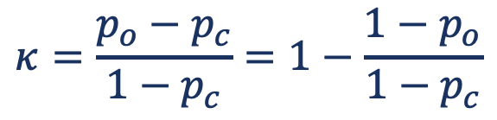
MODEL EVALUATION
$$κ=\frac{p_{o}−p_{c}}{1−p_{c}}=1−\frac{1−p_{o}}{1−p_{c}}$$
a | b
takeoff | takeoff
takeoff | cruise
cruise | cruise
turn | turn
$$κ=0.\overline{63}≈0.64$$
7/12
Notes:
To evaluate model performance, I computed Cohen's kappa coefficient between the model's predicted labels and the truth data. Like accuracy, the coefficient is a measure of agreement between two sets, but, unlike accuracy, it considers the possibility of chance agreement between the sets. We can see the equation here, where p_o is the observed agreement between a and b, and p_c is the chance agreement between a and b.
This table shows two example label sets. Because three of the four rows are the same, the accuracy score is 0.75.
Cohen’s kappa coefficient, however, is about 0.64 because some of the agreement between a and b could be due to chance.

Slide 8
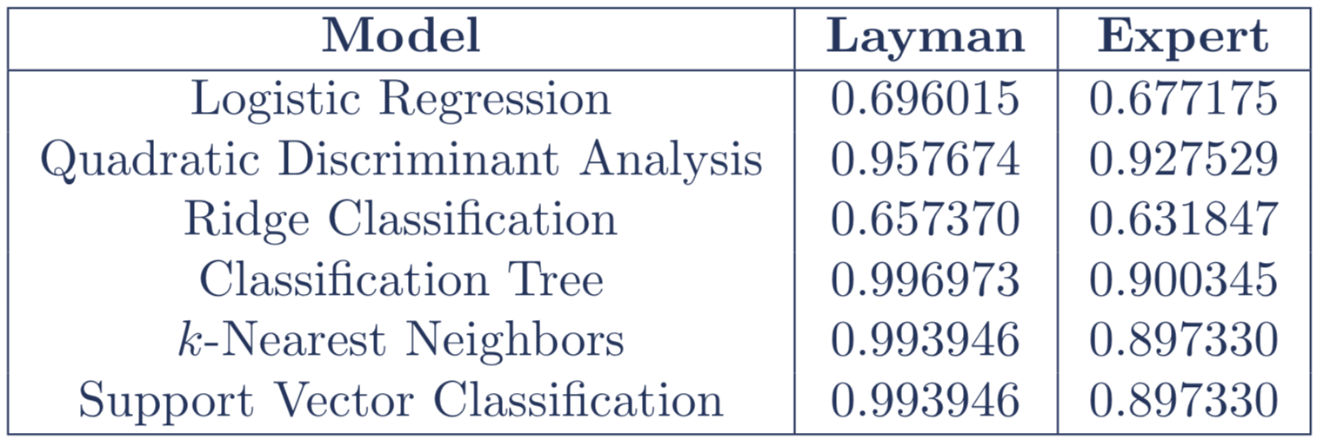
Results
8/12
Notes:
This table shows Cohen's kappa coefficient between
the layman's labels and the labels predicted by the best version of each of the six models. Similarly, it shows the coefficient between
the expert's labels and the labels predicted by each model. Clearly, some machine learning models can predict
the non-expert's labels very well, but the same models fail to predict
the expert's labels at the same level of performance.

Slide 9
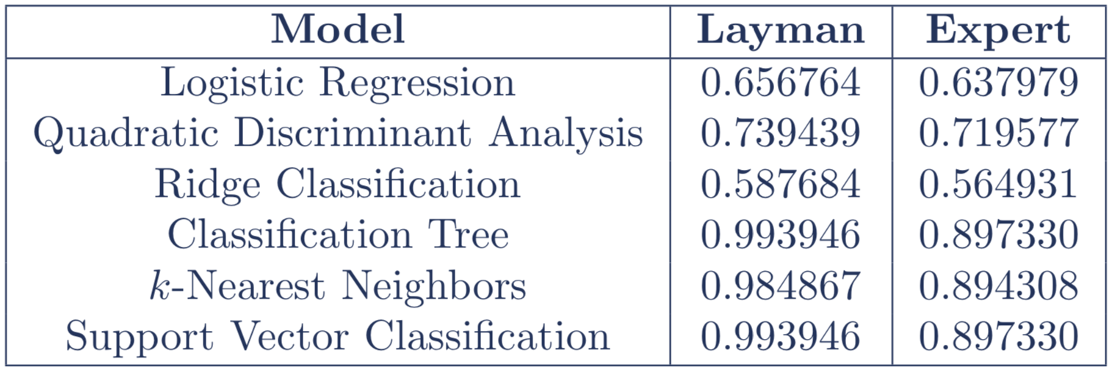
Restricted Results
9/12
Notes:
The expert system applies labels using just roll, pitch, and yaw data. Out of curiosity, I again computed the performance of the best models, but this time I removed all orientation data from the dataset. As expected, the models perform worse, but, aside from QDA, the kappa coefficients are relatively close to those computed with the full dataset.

Slide 10
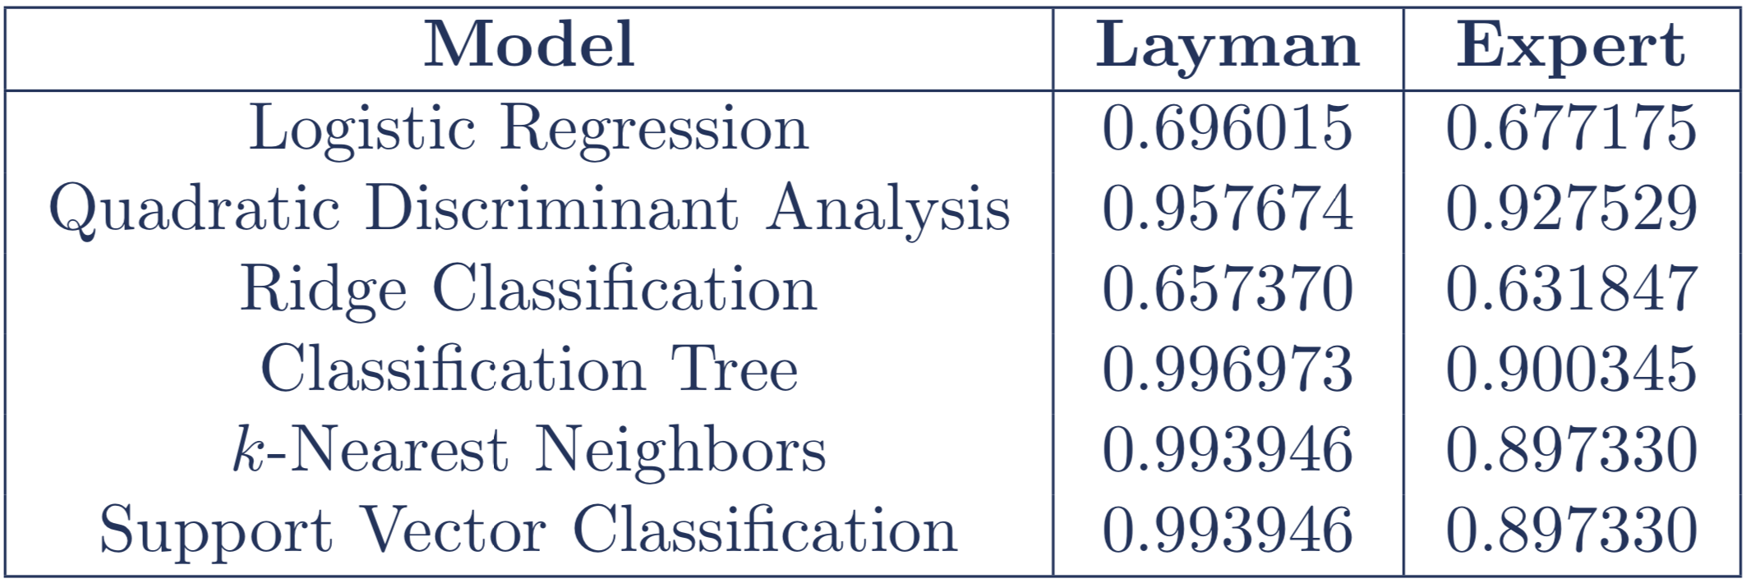
Impact
The layman is unreliable
A human observer needs expert knowledge
Does this apply to other problem domains?
The model fits the layman
Model will fit the expert
Model can replace the expert for future data
10/12
Notes:
The results indicate that the layman's label for a given observation is often not representative of the true aircraft maneuver for that observation. Thus, we can conclude that a human observer needs expert knowledge to accurately classify aircraft maneuvers. This conclusion likely applies to more than just aircraft maneuvers (for example, in evaluating the validity of crime-scene witness testimony), but further research is required to validate this claim. Although the results show that a model fit to the layman's labels does not adequately predict the expert's labels, they also show that the model fits the layman's labels
exceptionally well. The best model's kappa coefficient is 0.996973 (where 1 is the maximum possible value), so it is clear that the model is representative of the non-expert. It is assumed that an expert applies labels in a more consistent manner than does a non-expert, so it's likely that a machine learning model can fit an expert at least as well as it fits the layman. Thus, one could fit a model to an expert and then use such a model to classify large amounts of aircraft flight data. This could reduce manpower requirements -- at least for one's expert maneuver-labelers.

Slide 11
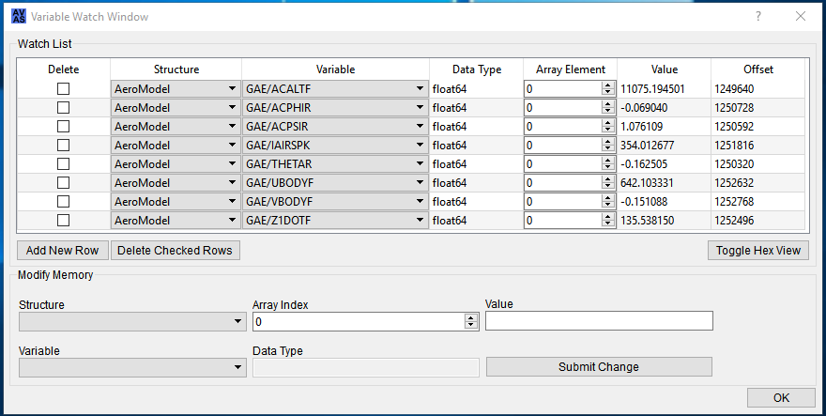
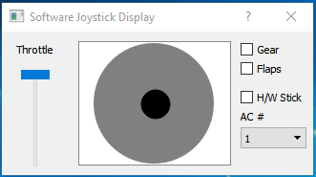
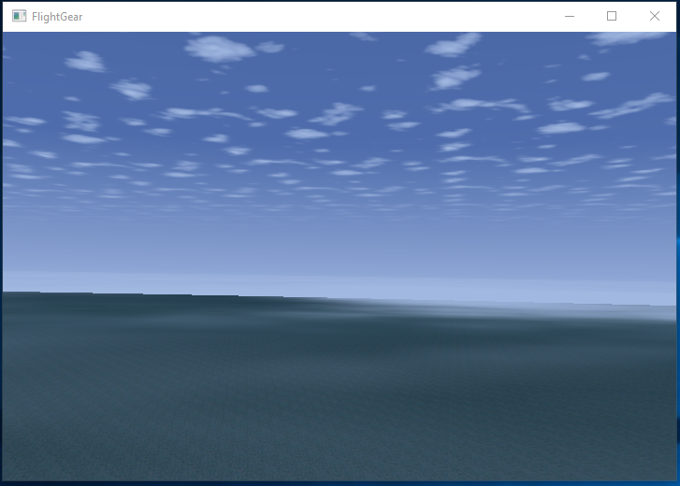
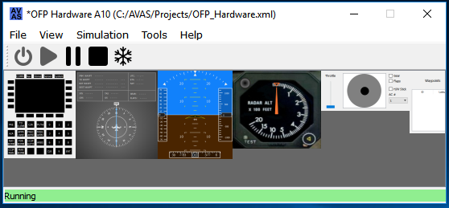
Future Work
AVAS = bad
Planes can perform more than three maneuvers
https://www.dailymail.co.uk/news/article-2001102/Thunderbirds-U-S-Air-Force-squadron-complete-daring-display-tight-formation.html
https://www.travelandleisure.com/articles/miraculous-airplane-emergency-landings
https://www.skydive.tv/project/catching_airplanes
11/12
Notes:
The AVAS, while useful for this research, is limited in scope. The control scheme is low-quality, the visual representation is sub-par, and the code is far too convoluted to allow for significant modifications. Future researchers who wish to affirm my conclusions should generate data with a higher-quality, professional simulator, or they should work to obtain real data from real aircraft. Additionally, future research should analyze whether the conclusions hold when the number of classes is significantly large.
A powered aircraft's movements can be classified by so much more than just takeoff, cruise, and turn, and future researchers would do well to apply more labels to their observations.

Slide 12
Thanks for watching
12/12
Notes:
Thank you for watching, and let me know if you have any questions.

